Slide 1
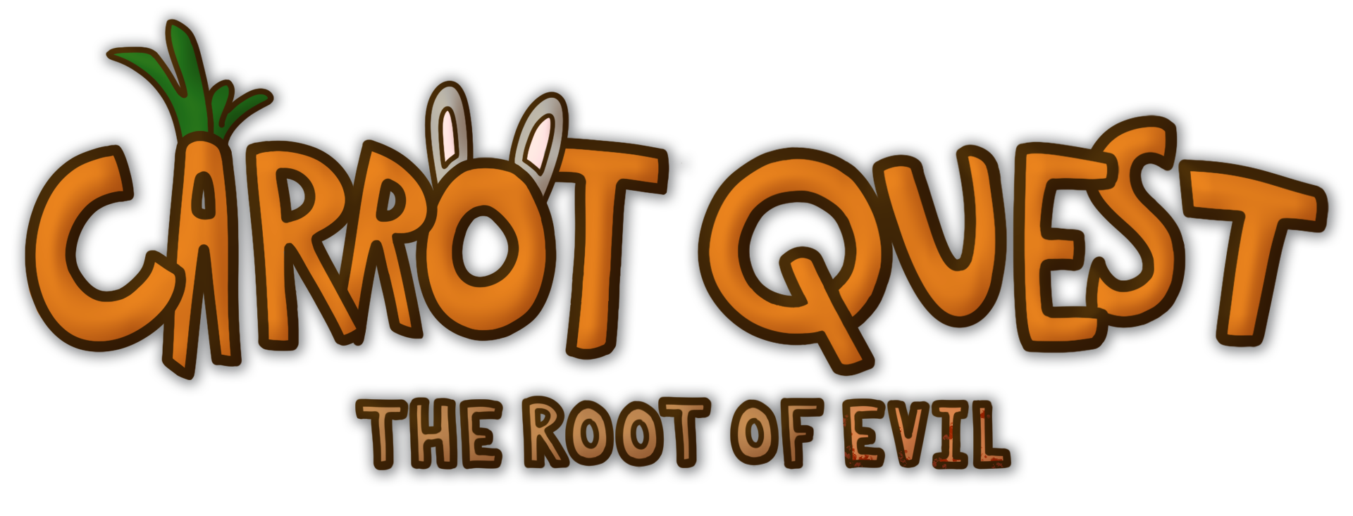

By Dark Root Studios

Slide 2

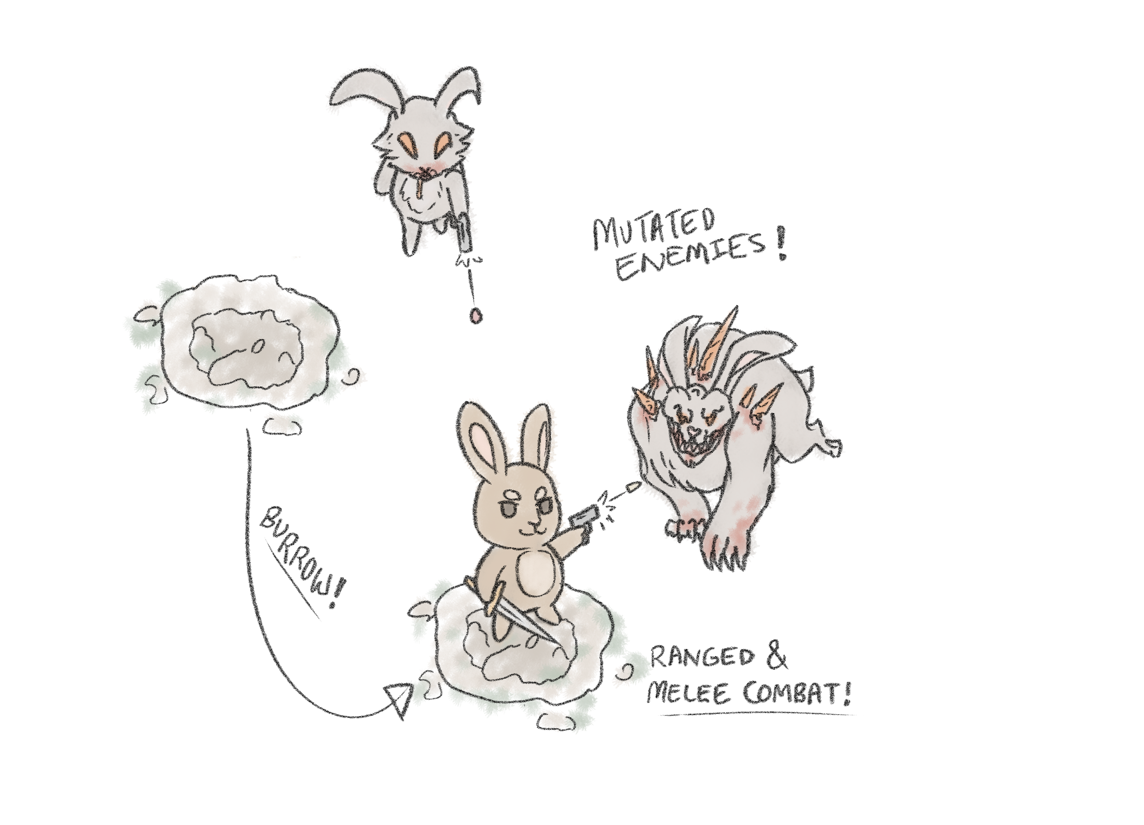
What is Carrot Quest ?
Platform: PC ESRB Rating: T Number of Players: 1
A bun with a GUN !
Mow through enemies in unique top-down combat, using the dodge and burrow mechanic to quickly traverse the battlefield!
Fight off the hideously mutated beasts created by the Carrot Curse and save the village of Bunnyville!

Slide 3
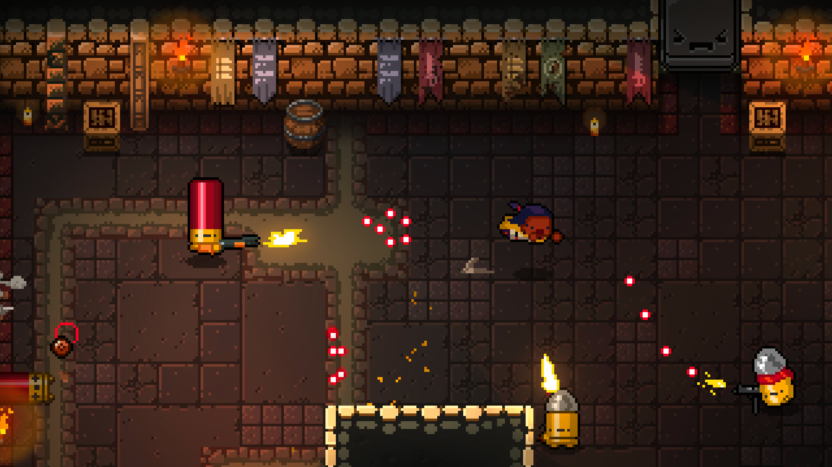
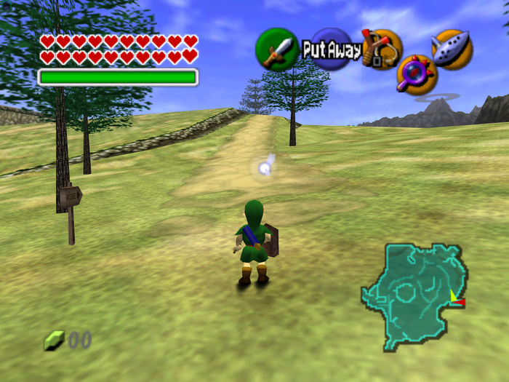
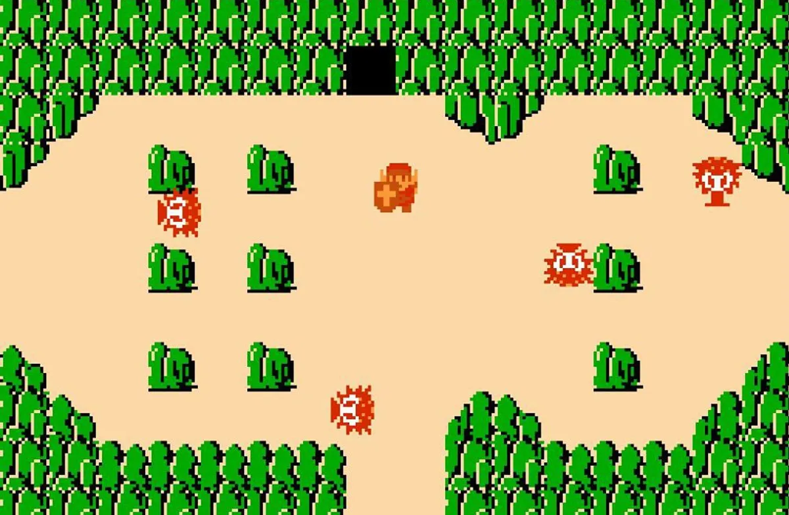
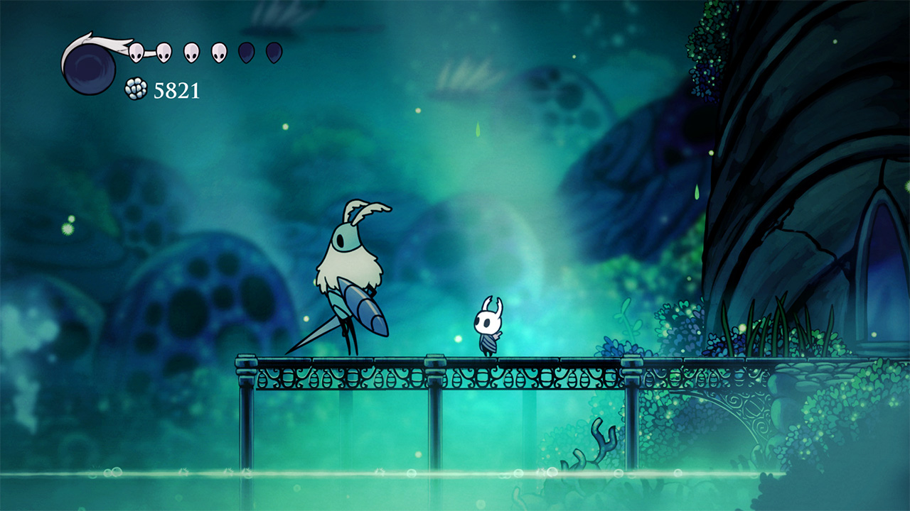
What games are similar ?
Imagine Enter the Gungeon meets The Legend of Zelda and Hollow Knight
Top-down gun combat like Enter the Gungeon
+
Adventure and exploration of the early Zelda games
+
Melee combat & the themes and art of Hollow Knight

Slide 4
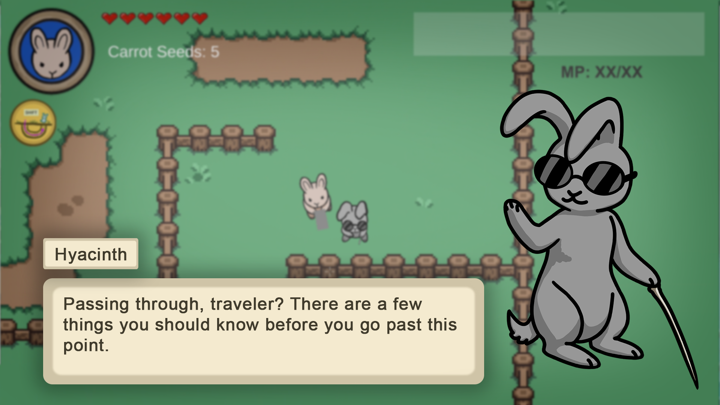
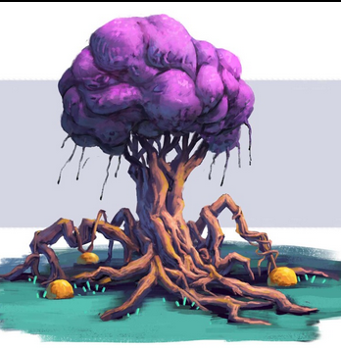
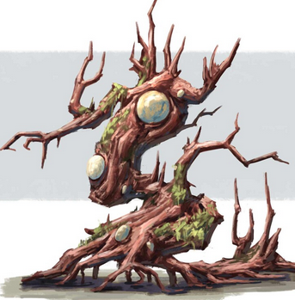
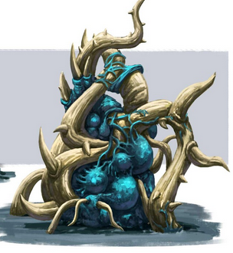
Explore the world of Carrot Quest
Enter a nature filled world with darkness and corruption lurking behind the corners
Watch out for mutated overgrowth! The Curse has infected the very land itself
Explore a variety of biomes such as Plains, Forest, Mountains, Ice, and Desert

Slide 5

What evil lies beneath Bunnyville?
Piece together the secrets of the past from the remnants of the previous bunny civilization, the Carrot Kingdom…
The Carrot Curse is what is causing the mutations in the world. What happened in the past to cause this curse?
Find and put an end to the source of the curse once and for all!

Slide 6
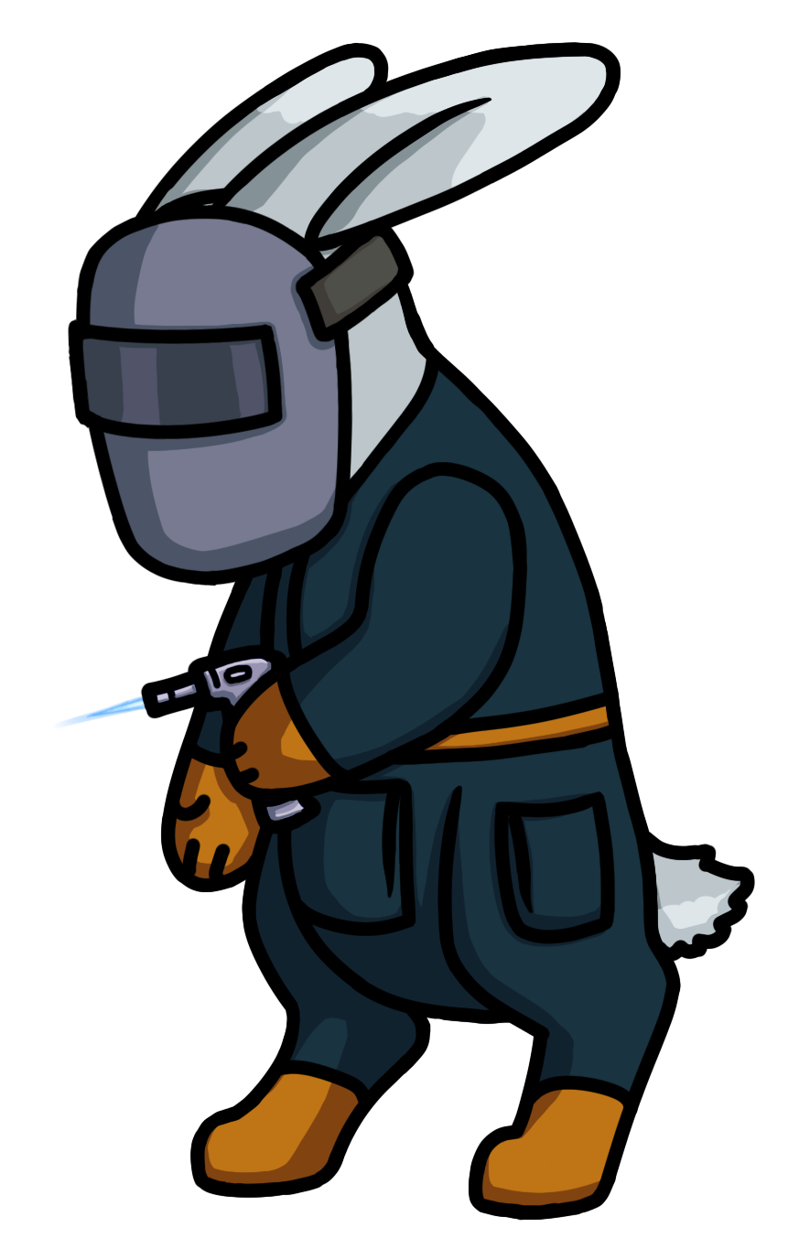
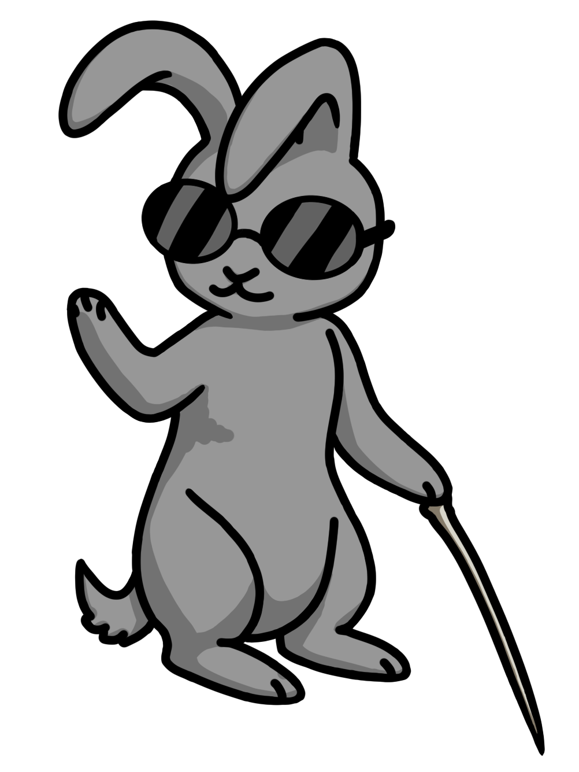
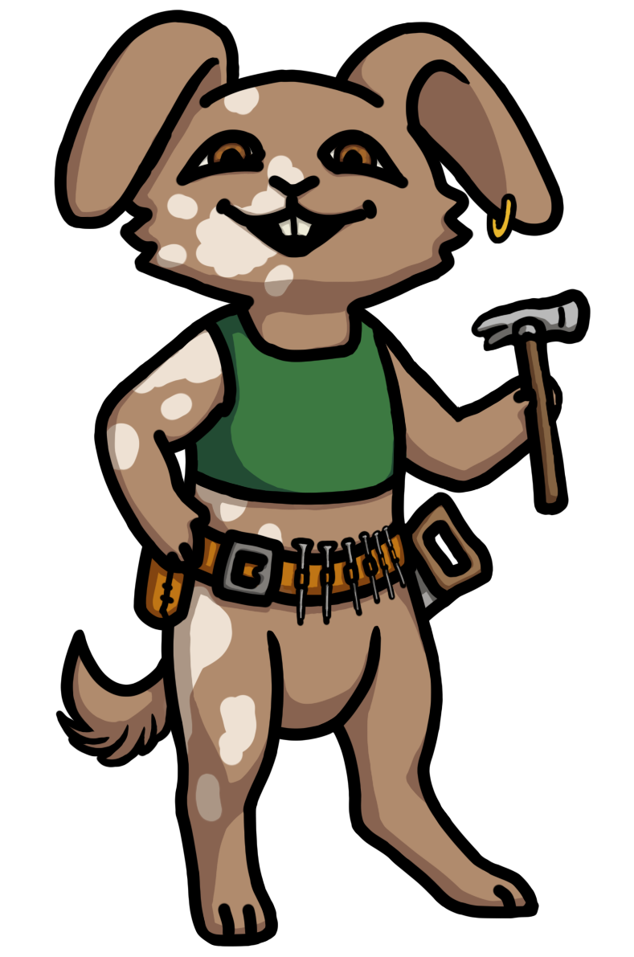

Who are you trying to save?
Meet a large cast of villagers, each with interests and secrets of their own
These newfound friends (or enemies) will be hiding the secrets of how to find the curse’s source
Complete side quests for the villagers to build relationships with them, and learn what they know about the curse
Hyacinth
Oakly
Dancer
Dewdrop
AND MORE !

Slide 7
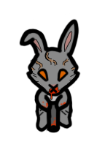

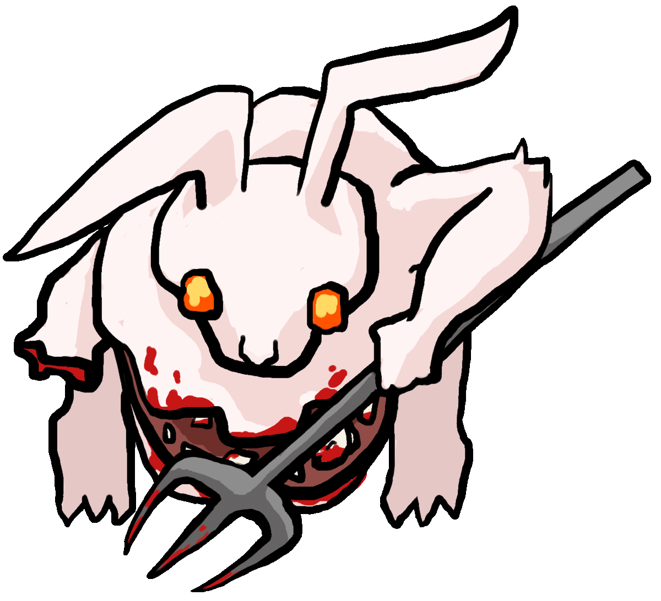
Beware !
Slime (Melee)
Bullet Bunny
(Ranged)
The cursed creatures of this world will stop at nothing to eat you and your carrots!
Defeat a variety of foes mutated in unique ways by the Curse, from the simple slime all the way to the horrifying Pitchfork boss!
Bear Bunny
(Massive Melee)
Pitchfork
(Massive Melee, summons Bullet Bunnies)

Slide 8

So what’s unique ?
An exploration heavy game with compelling NPCs and a mystery to solve
Fluid combination of ranged and melee in a top-down fighting game
AND
New Burrow Mechanic to quickly traverse the battlefield
A huge variety of skills and weapons to combo for dynamic combat !

Slide 9
Burrowing!
The player has a unique ability thanks to their bunny “hare”-itage: Burrowing!
Dig burrows that allow you to avoid enemies, bypass obstacles, and quickly teleport around the battlefield.
Be sure to use it to explore every cursed nook and cranny.
What does it do?
Invincible while underground.
Increases your movement speed by 50%
You cannot attack while burrowing.
You can travel to and from each burrow.
Only one set of burrows can be active (initially)
You can shoot at a burrow and the bullet will come out the other side.

Slide 10

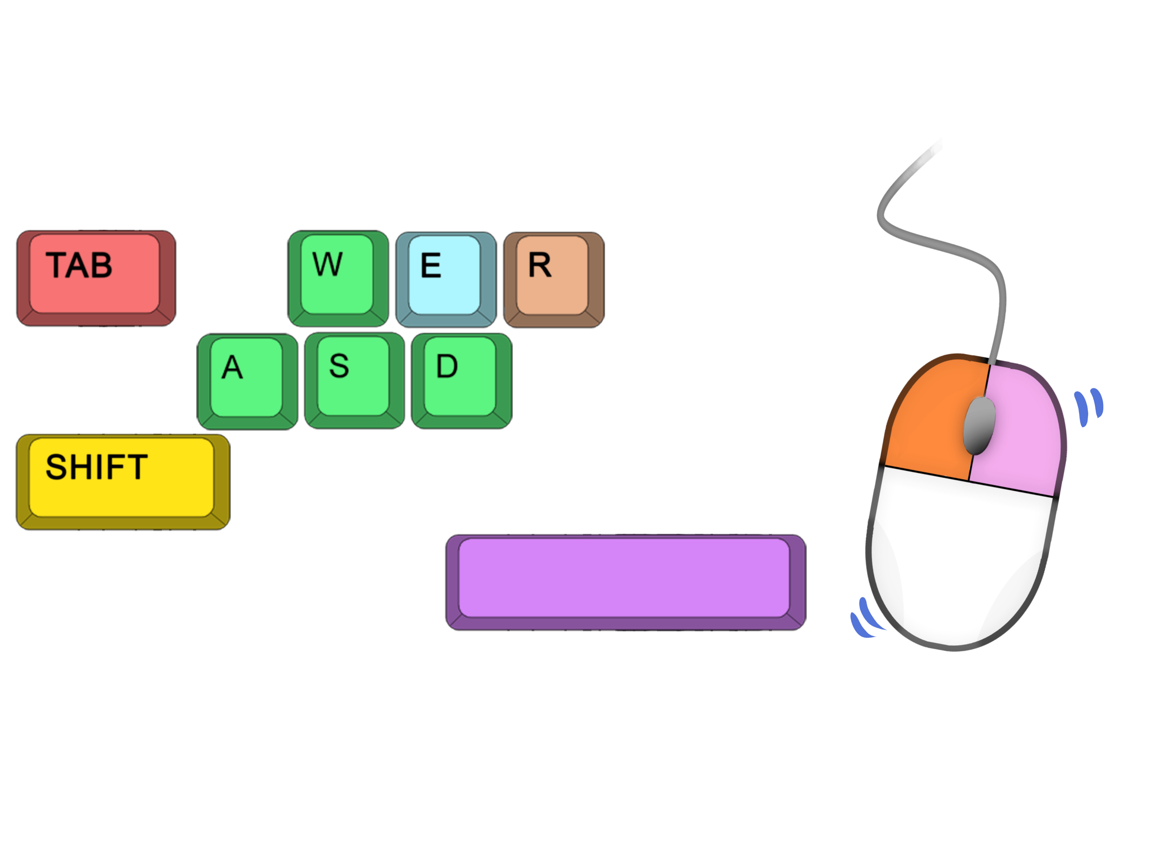
Burrowing: How does it Work?
Burrow by holding SHIFT and moving around.
When you release SHIFT, a burrow will be created linking your entrance and exit points.
Travel back through a burrow by pressing E on it. Get the drop on enemies!
Creating a burrow removes your previous burrow.
You can only start burrowing with full Burrow Stamina, and you can only burrow until your Burrow Stamina runs out
Hold SHIFT to Burrow
Press E to travel back through your burrow!

Slide 11



Dodging and Attacking
Attack with both melee and ranged using the two mouse buttons
LMB to shoot, RMB to melee attack!
Dodge attacks by pressing SPACE
Move fluidly around the battlefield and quickly escape attacks!
Switch Weapons by pressing TAB
Swap between weapons such as the slingshot, the revolver, and the cannon for dynamic combat!
TAB to switch weapons
E to Interact
Move Mouse to Aim
R to Reload
LMB to Shoot
WASD to Move
RMB to Melee Attack
Hold SHIFT to Burrow
SPACE to Dodge

Slide 12
Weapon Combos
The player will come across quite the range of weapons as they explore.
Whether it be through shops or from finding them across the cursed lands, there will surely be a gun that fits every player’s playstyle.
Combo long-ranged weapons and melee weapons for devastating effects. Set an enemy on fire? Use the stick melee weapon to get a makeshift torch!
Experimenting with different weapon combos is key to getting out of Bunnyville alive and in one piece.

Slide 13



Where can I play?
COMING SOON TO STEAM AND EPIC !
Carrot Quest will be available as a one-time purchase of $9.99
What do you get?
A large exploration and gun combat game with a mystery to solve and memorable characters.
Around 10 hours of gameplay, with replay-ability in how you vary your weapons and skills.

Slide 14
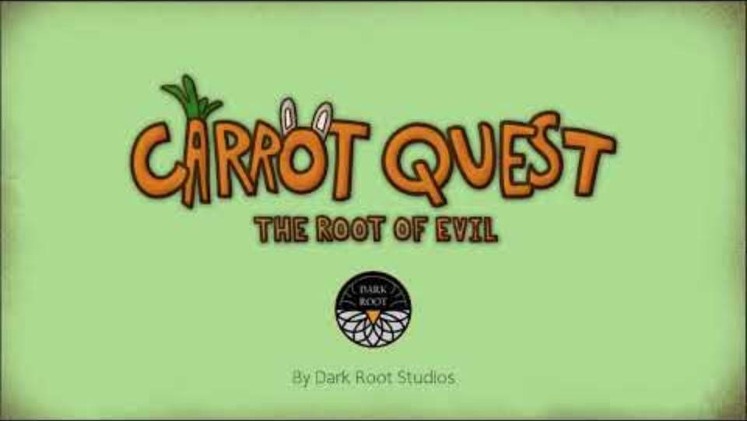
Gameplay Demo
Link to video: https://youtu.be/CX6Q8FG9nk0

Slide 15
Conclusion
A top-down adventure-shooter
Lots to explore in the isometric world
Villager NPCs to talk to and learn from
Uniquely mutated enemies
Burrow mechanic
Many abilities and weapons combo for interesting combat
Find the source of the Carrot Curse and save Bunnyville!
COMING SOON IN 2024…

